Slide 1


Slide 2


Presentation for everyone
Themimopsatgmail.com
Remember me
Log In
Log In

Slide 3



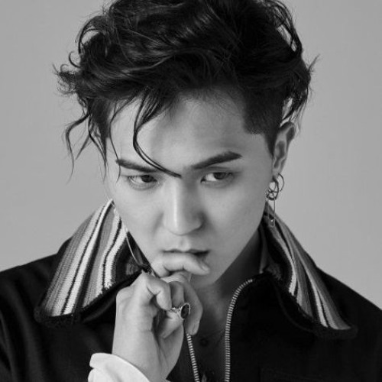

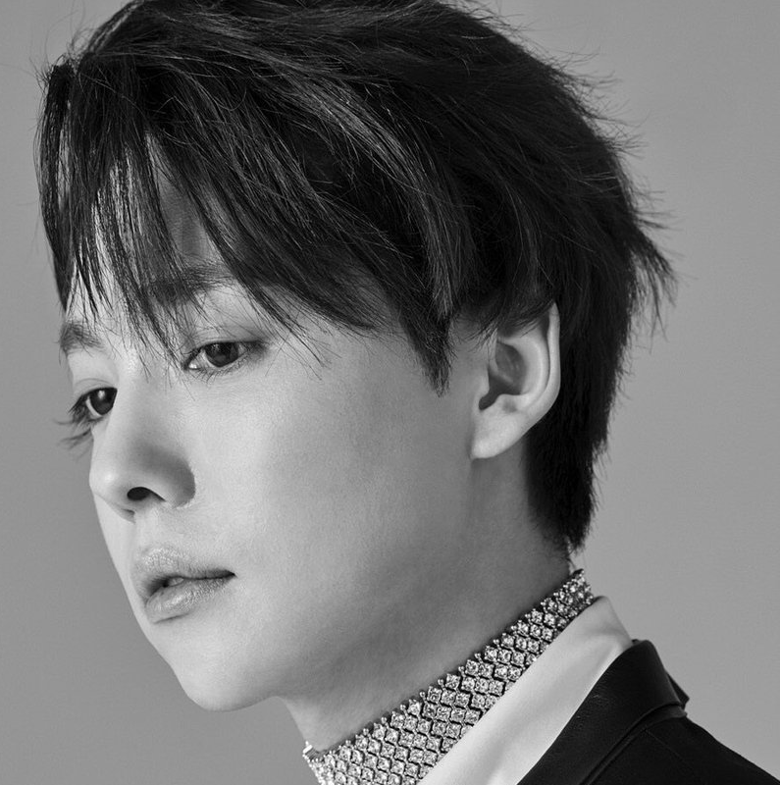
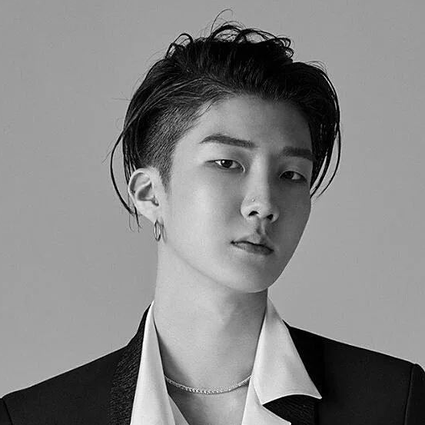
<
THE TITLE
Home
Search
This presentation is about presentation is about presentation is about presentation is about presentation.
Playlist
Members Of The Group
Song
Mino
Kang Seungyoon
Kim
Jinwoo
Lee Seunghoon
<

Slide 4



<
THE TOPICS
Home
Search
Playlist
Topic
Subtopic 1
Subtopic 2
Subtopic 3
Subtopic 1
Subtopic 2
Subtopic 3
<

Slide 5
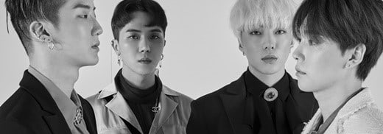
< >
STAN WINNER
<
Home
SUBTOPIC 1
Search
Playlist
START
FOLLOWING
…
Topic
Subtopic 1
OVERVIEW
REVIEW
PHOTO
Subtopic 2
This presentation is about presentation that about presentation is about presentation that about presentation is about presentation that about presentation is about presentation that about presentation .
Subtopic 3
<

Slide 6
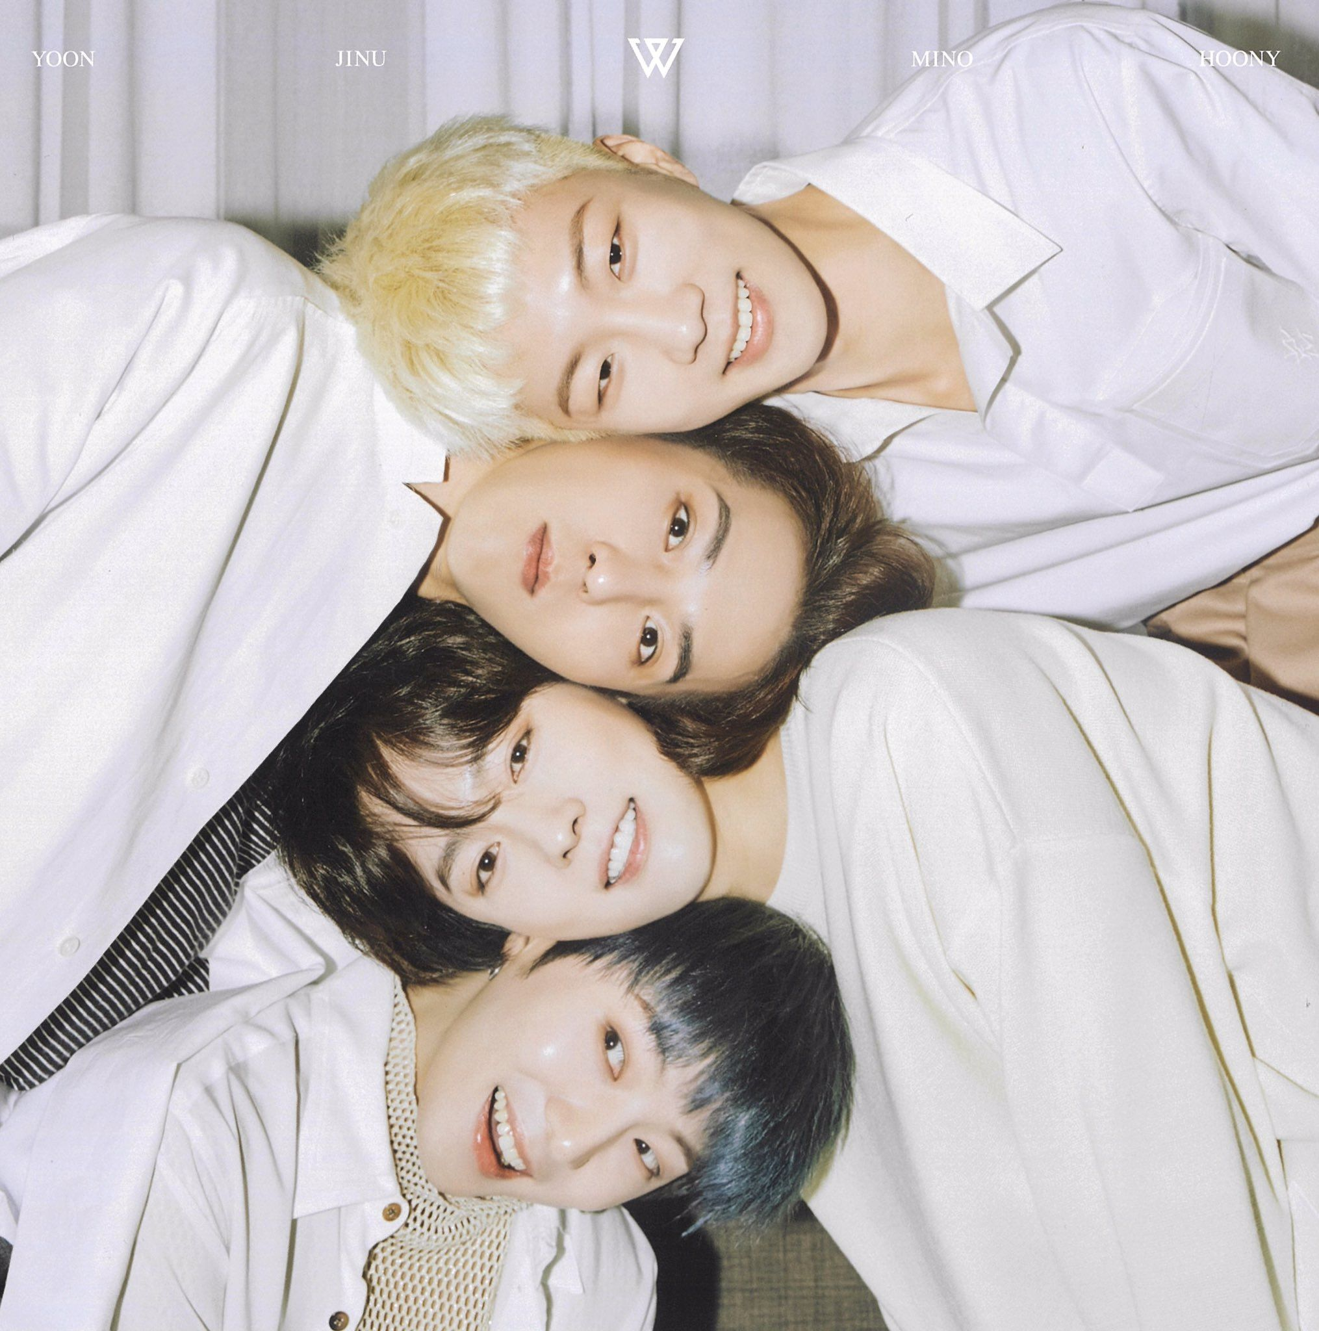
< >
STAN WINNER
<
Home
THE TOPIC
Search
Playlist
This is point number one
This is point number two
This is point number four
This is no point at all
Topic
Subtopic 1
Subtopic 2
Subtopic 3
<

Slide 7

<
Home
THE TOPICS
Search
Playlist
START
FOLLOWING
…
Topic
Subtopic 1
This is point number one
This is point number two
This is point number four
This is no point at all
Subtopic 2
Subtopic 3
<

